Slide 1

Bootstrap 5
CSS Framework
Lecture - 01
Instructor:
Muhammad IbTaSaM

Slide 2

Instructor: Muhammad IbTaSaM

Slide 3
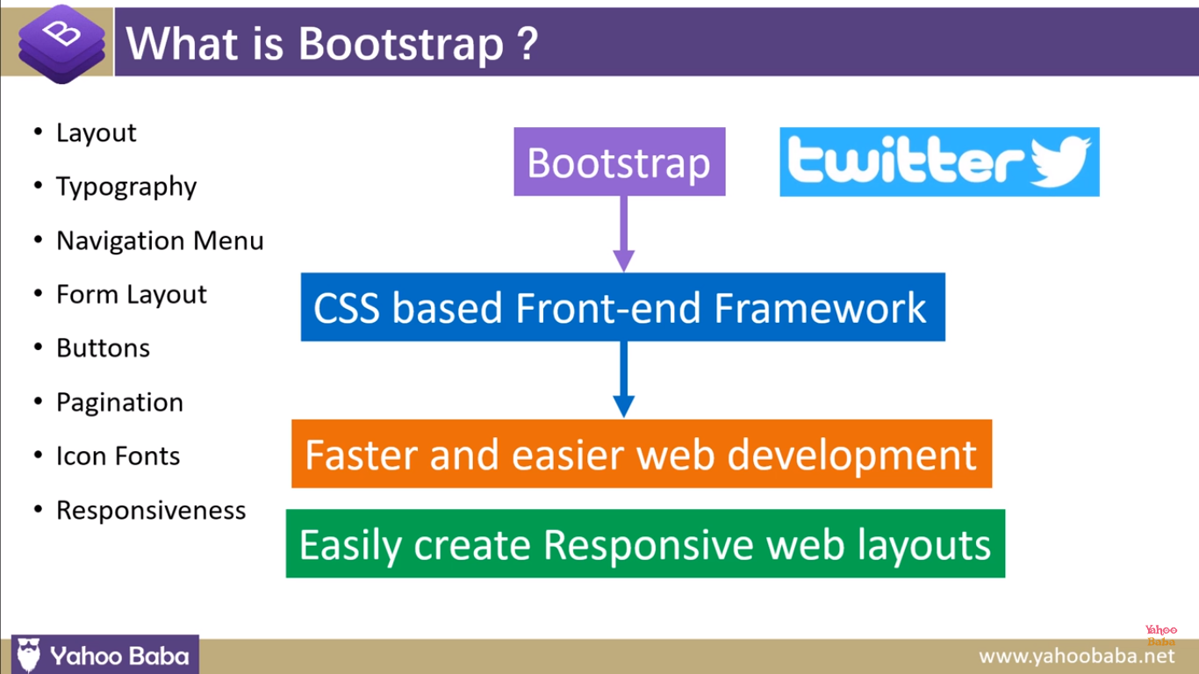
Instructor: Muhammad IbTaSaM

Slide 4
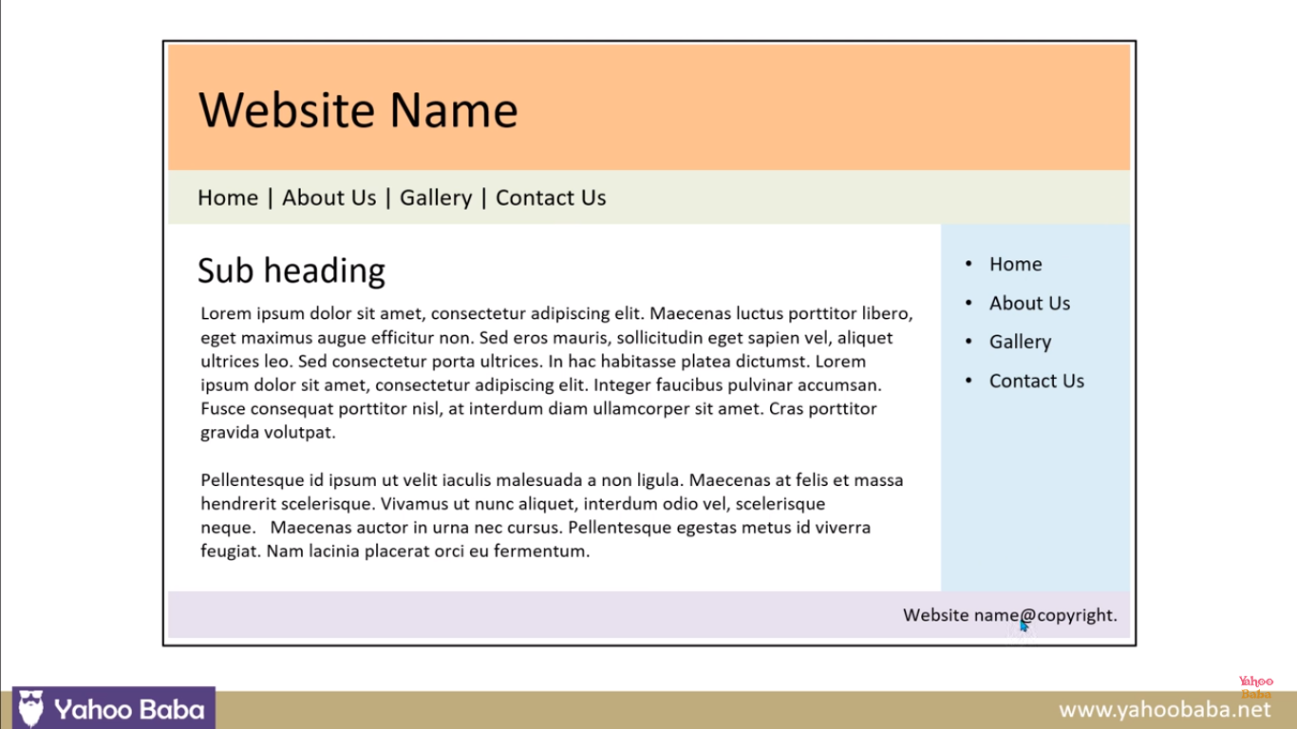
Instructor: Muhammad IbTaSaM

Slide 5
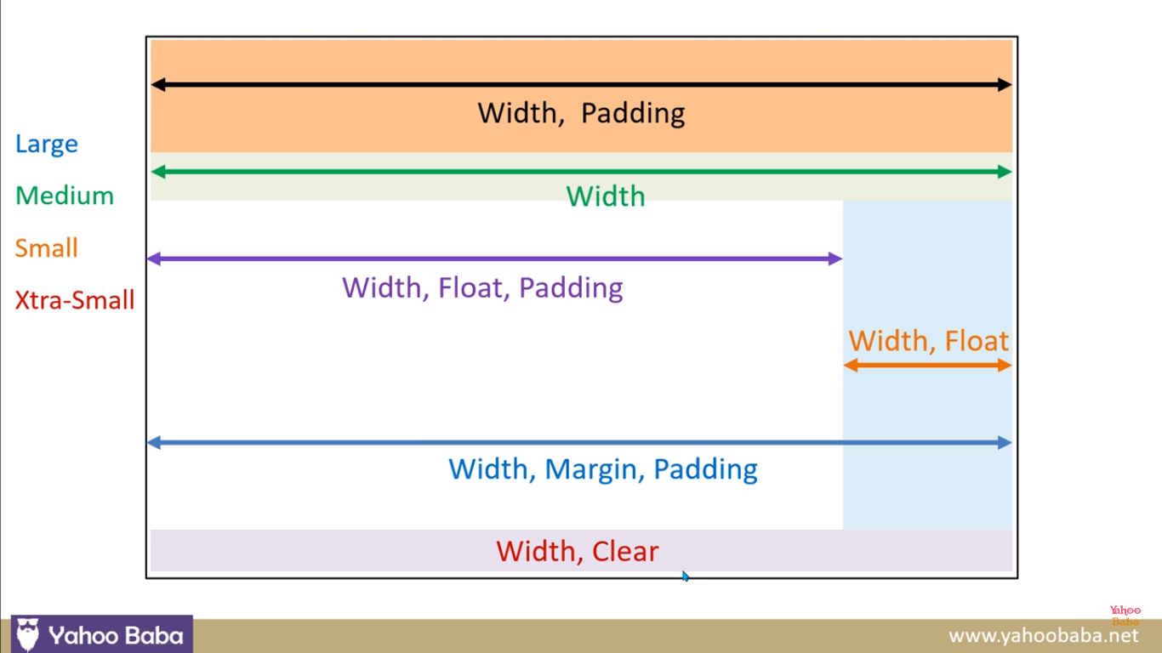
Instructor: Muhammad IbTaSaM

Slide 6
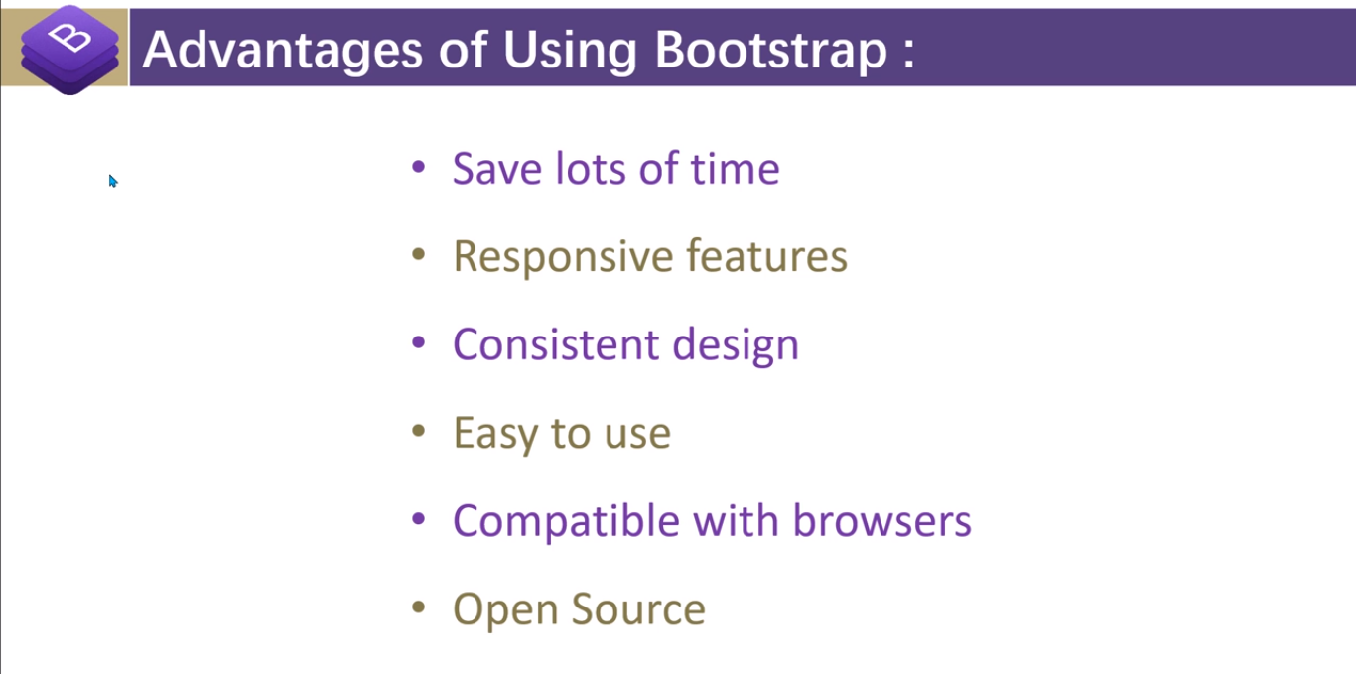
Instructor: Muhammad IbTaSaM

Slide 7
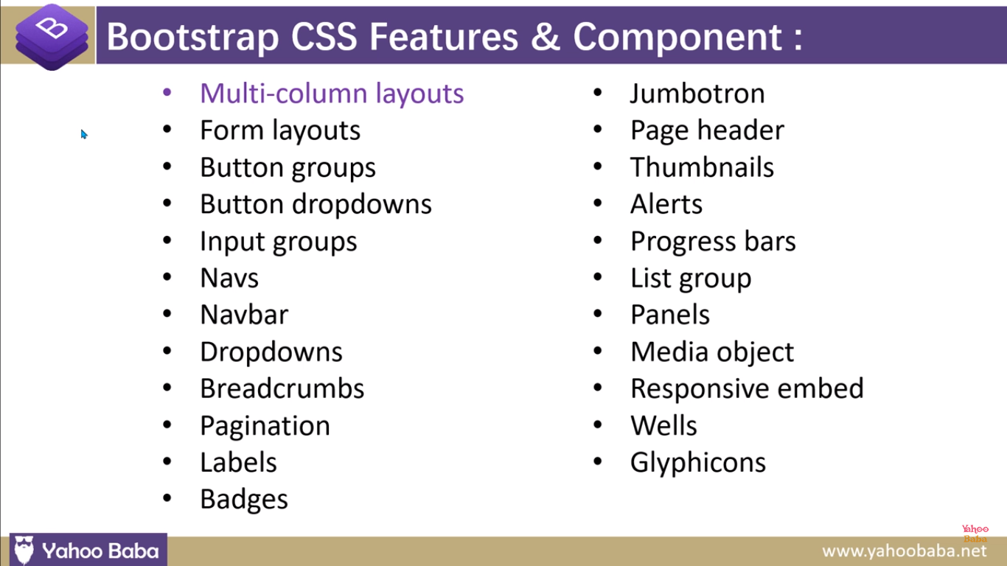
Instructor: Muhammad IbTaSaM

Slide 8
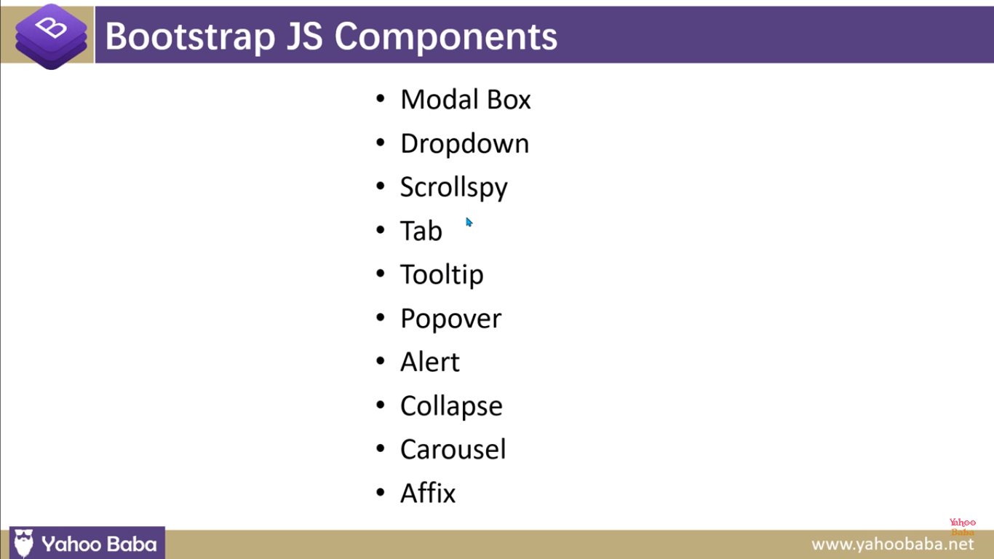
Instructor: Muhammad IbTaSaM

Slide 9
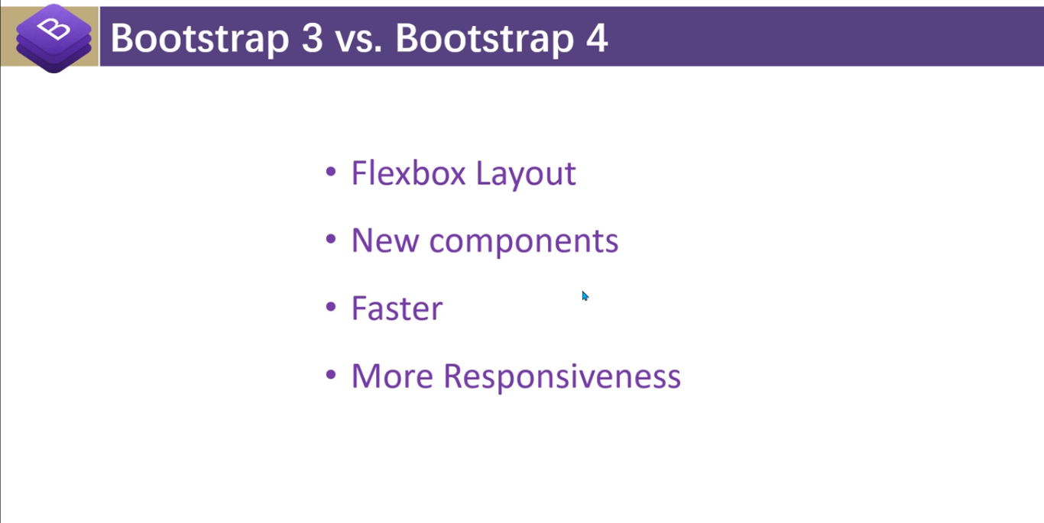
Instructor: Muhammad IbTaSaM

Slide 10
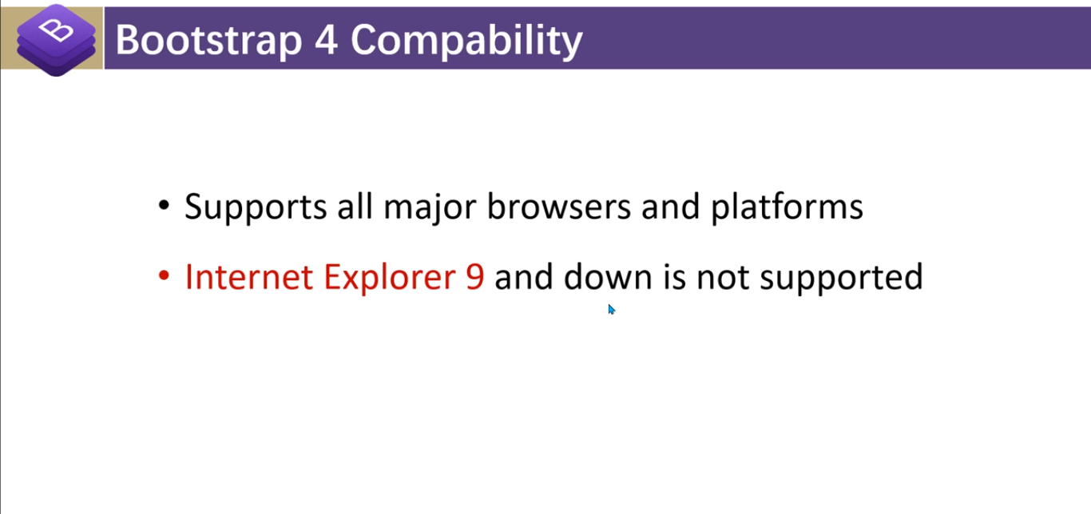
Instructor: Muhammad IbTaSaM

Slide 11
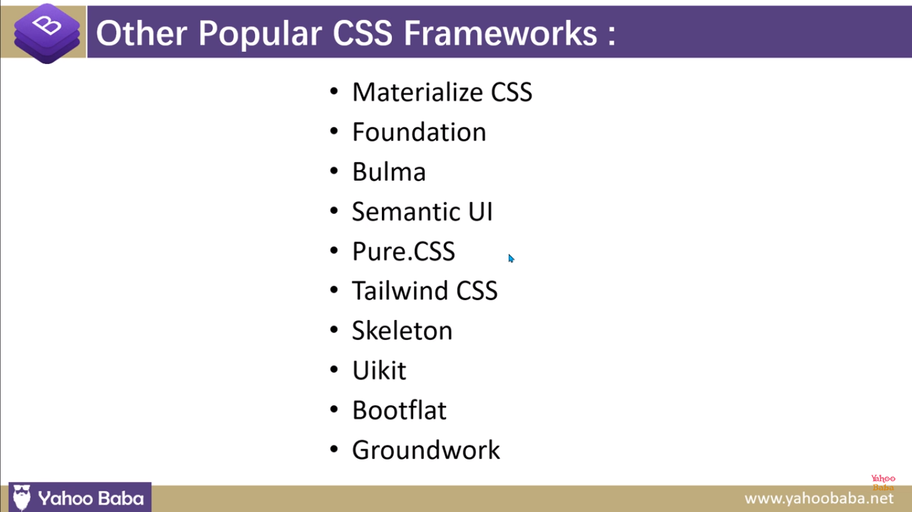
Instructor: Muhammad IbTaSaM

Slide 12
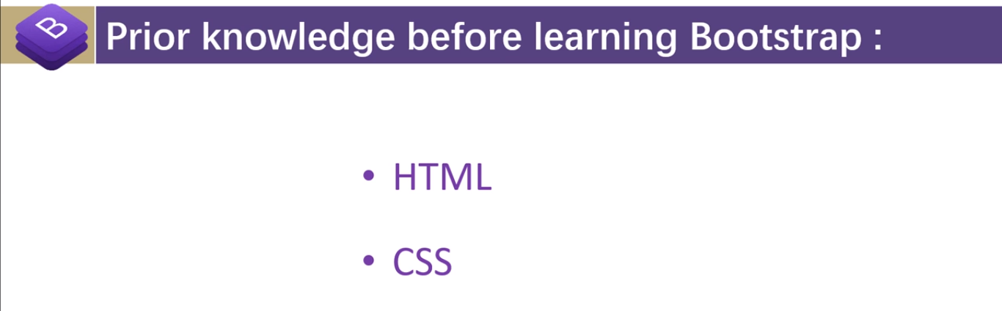
Instructor: Muhammad IbTaSaM

Slide 13
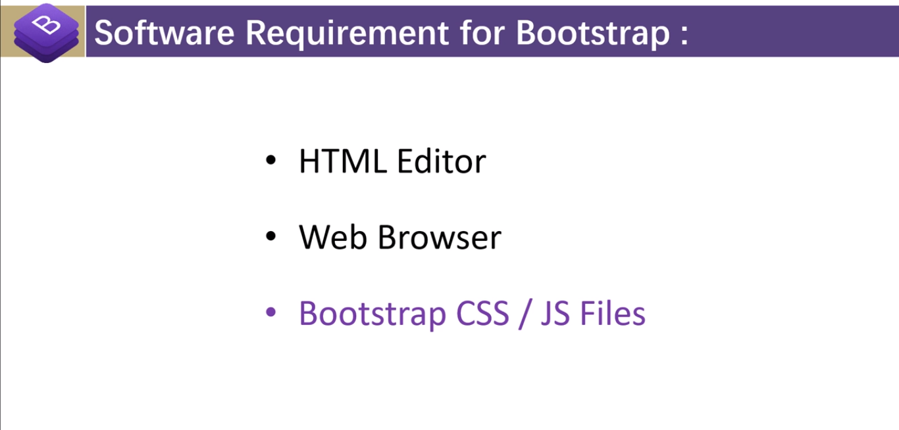
Instructor: Muhammad IbTaSaM

Slide 14

Instructor: Muhammad IbTaSaM

Slide 15




Thank You
BEST FOR You IbTaSaM 116
Muhammad Ibtasam
0304 - 6547211
ibtasam116@gmail.com

